Slide 1
Lecture 13 – Task Structuring
COMP 3700: Modeling and Design
Chapters 15 & 18: Designing Client/Server Software Architectures & Designing Concurrent and Real-Time Software Architectures
Gomaa, 2011

Slide 2
Steps for Creating Initial Concurrent Communication Diagram
Start with conceptual static model and software context class diagram
Conceptual static model shows the separation of the hardware/software of the system
Software context class diagram depicts the external classes of the system with the hardware/software depicted as an aggregate class (black box)
Remove the actors from the software context class diagram
Depict the aggregated hardware/software class in the software context class diagram as a white box, showing the internal subsystems
Identify whether subsystems are <<service>> or <<client>> and mark them all as <<subsystems>>
Two stereotypes
Be sure that the white box system has a name and give it the stereotype of <<software system>>
Identify and represent the whitebox subsystems as active or passive
Change the verbs on the lines of on the modified software context class diagram to describe the specific information being passed (e.g., customer input, display information, printer output, etc.) – these are the messages
Denote (using arrows) whether the messages are asynchronous or synchronous

Slide 3
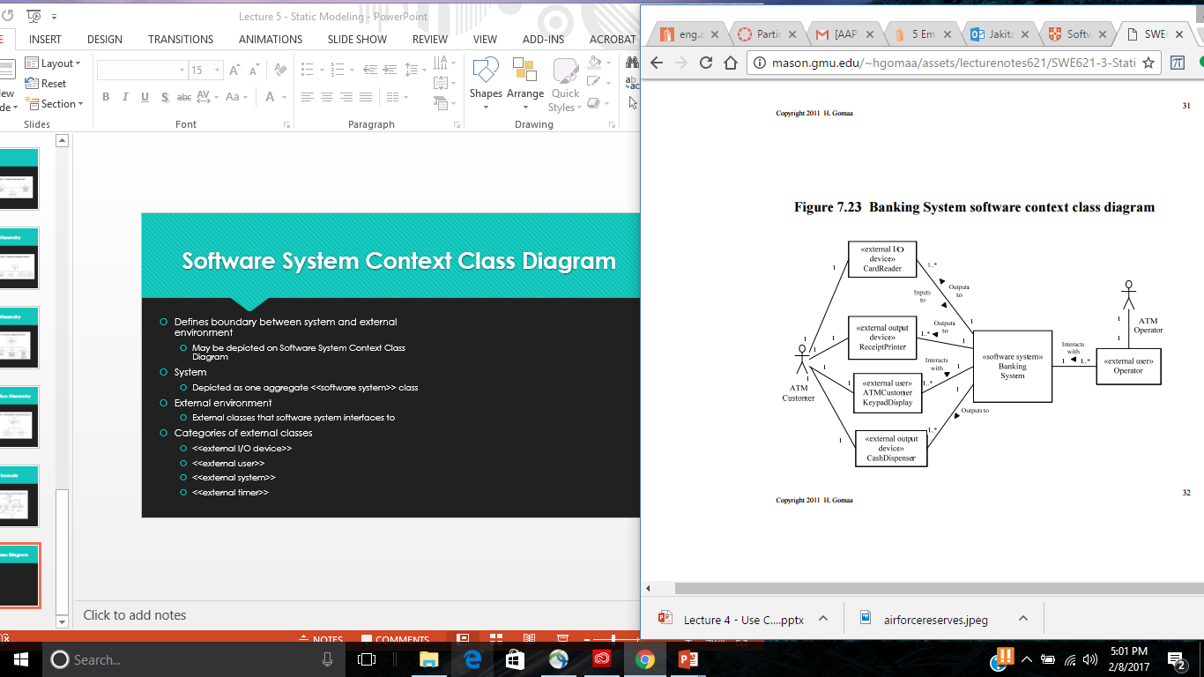
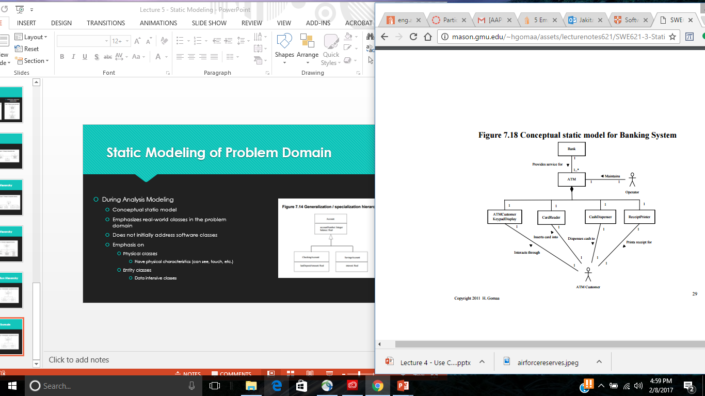
Step 1: Start with conceptual static model and software context class diagram

Slide 4
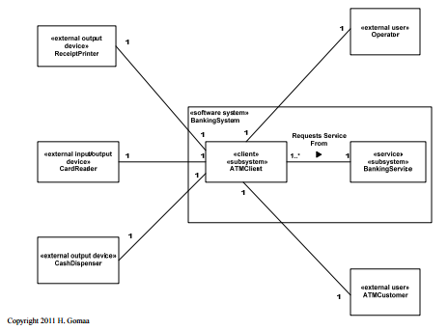
Steps 2 and 3: Remove the actors from the software context class diagram and deaggregate the hardware/software system blackbox into a white box

Slide 5
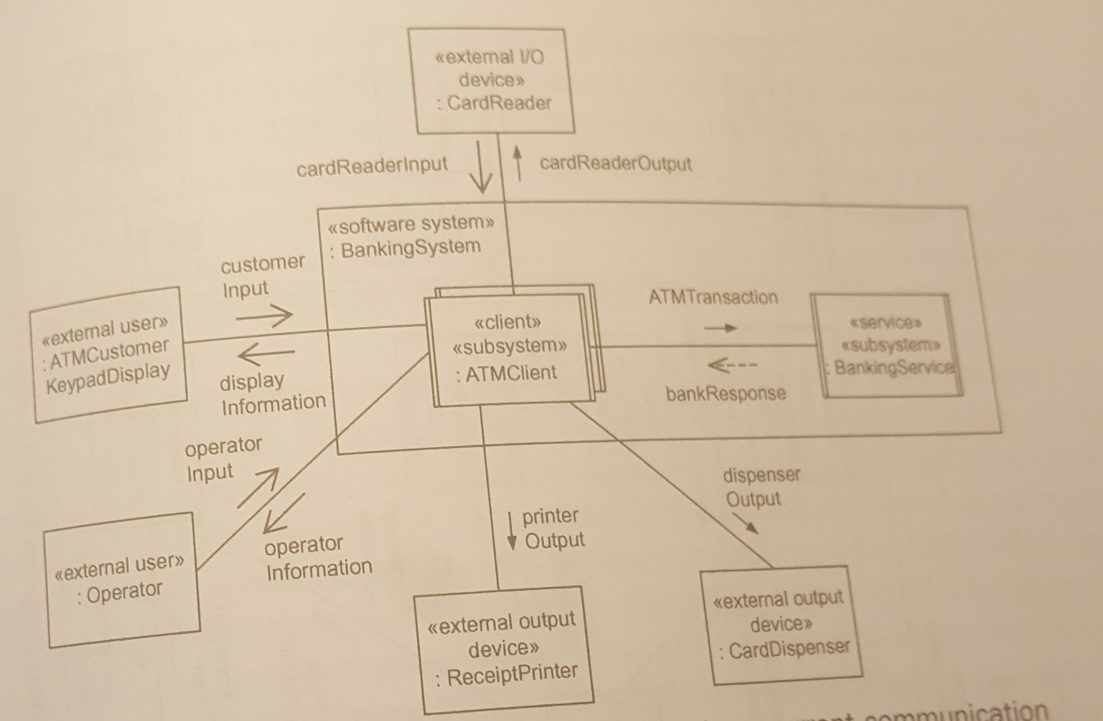
Steps 4 - 6
Identify and represent the whitebox subsystems as active or passive
Change the verbs on the lines of on the modified software context class diagram to describe the specific information being passed (e.g., customer input, display information, printer output, etc.) – these are the messages
Denote (using arrows) whether the messages are asynchronous or synchronous

Slide 6
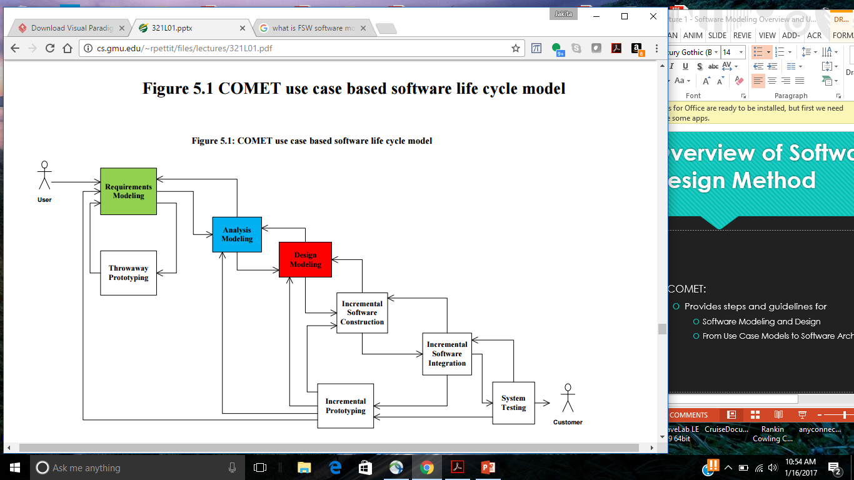
COMET Use Case Based Software Life Cycle Model
Develop Software Requirements Model
Develop Software Analysis Model
Develop Software Design Model
Design Overall Software Architecture (Chapter 12, 13)
Design Distributed Component-based Subsystems (Chapter 13, 15)
Structures Subsystems into Concurrent Tasks (Chapter 18)
Design Information Hiding Classes (Chapter 14)
Design Detailed Software Design
First, we must transition from Analysis to Design

Slide 7
Structure System Into Tasks
Concurrent Design with UML
Concurrent task structuring criteria
Structure analysis model into concurrent tasks
Task is an active object
Task has thread of control
Consider concurrent nature of system activities
Determine concurrent tasks
Define task interfaces
Support for concurrent tasks
Operative system services: multi-tasking kernel

Slide 8
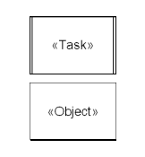
Active and Passive Objects
Objects may be active or passive
Active object
Concurrent Task
Has thread of control
Also called a process or thread
Passive object
Information Hiding Object
Has no thread of control
Operations of passive object are executed by task
Operations execute in tasks’s thread of control
Directly or indirectly
Software Design terminology
Task refers to active object
Object refers to passive object

Slide 9
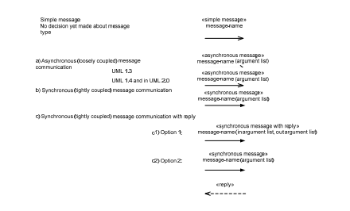
UML notation for messages

Slide 10
Task Structuring Criteria
Event driven task
Activated by external event (e.g., interrupt)
Periodic task
Activated by timer
Demand driven task
Activated by arrival of internal message

Slide 11
I/O Task Structuring Criteria
Event driven I/O task
Task for each event (interrupt) driven I/O device
Event driven device generates interrupt
Periodic I/O task
Task for each polled I/O device
I/O device (usually input) sampled at regular intervals
Demand driven I/O task
Task for each passive I/O device (usually output)
Computation overlapped with output

Slide 12
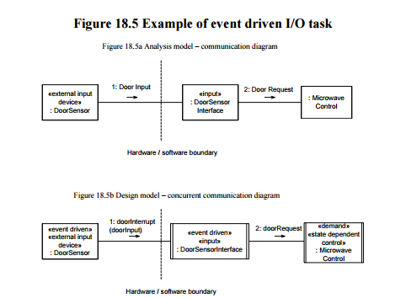
Event Driven I/O Task
Device Driver
One task for each event driven I/O device
Activated by device I/O interrupt
Reads input
Converts to internal format
Disposes of input
Sends message containing data
Signals event (message with no data)
Writes to data store

Slide 13
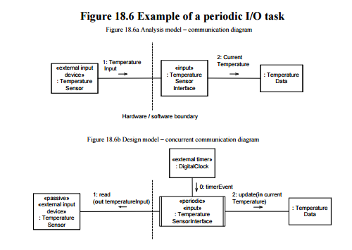
Periodic I/O Task
Task for each polled I/O device
Activation of task is periodic
Samples I/O device
Period I/O task
Activated by timer event
Performs I/O operation
Waits for next timer event

Slide 14
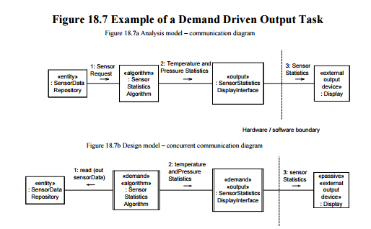
Demand Driven I/O Task
Task for each passive I/O device (usually output)
Passive I/O device does not need to be polled
Computation overlapped with output
Task output to device overlapped with
Computational task that produces data
Usually for passive output device
Demand driven I/O task
Passive input devices more likely to be polled
Periodic input task

Slide 15
Internal Task Structuring Criteria
Periodic task
Task for each periodic activity
Demand task
Task for each demand driven internal activity
Control task
Task executes state machine
User interaction task
Task for each sequential user activity

Slide 16
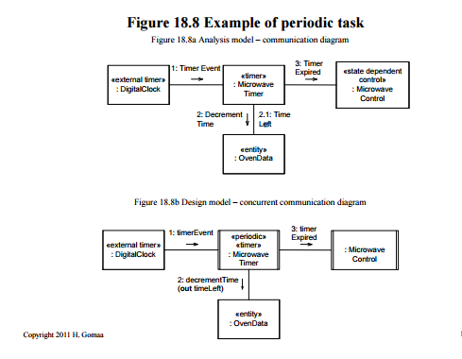
Periodic Task
Task for each periodic activity
Task activated periodically
Activated by timer event
Performs activity
Waits for next timer event

Slide 17
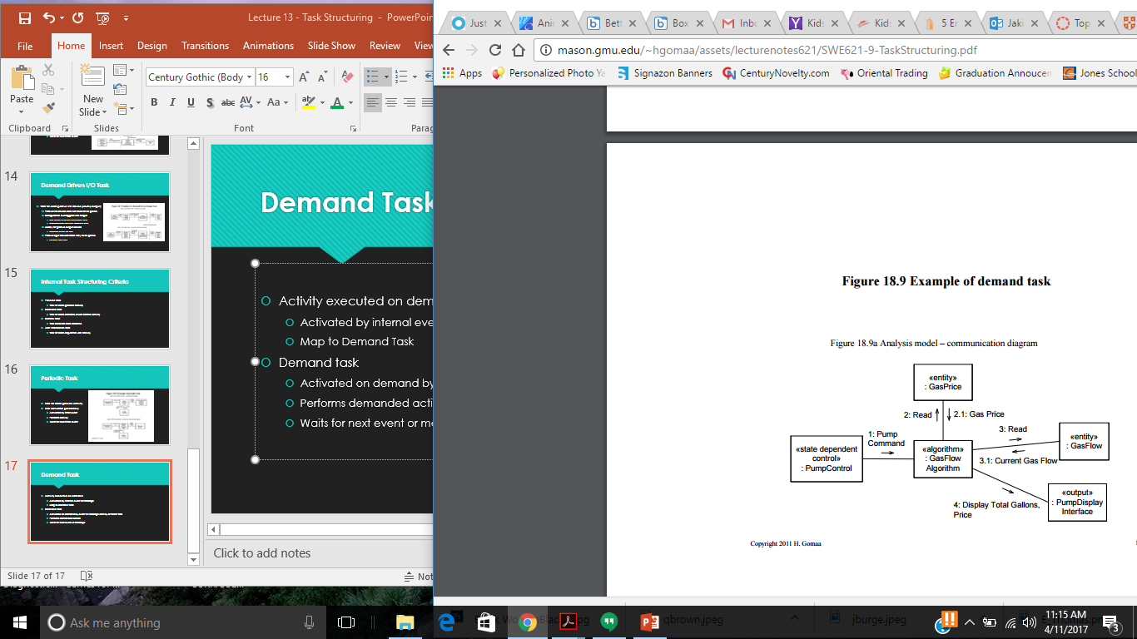
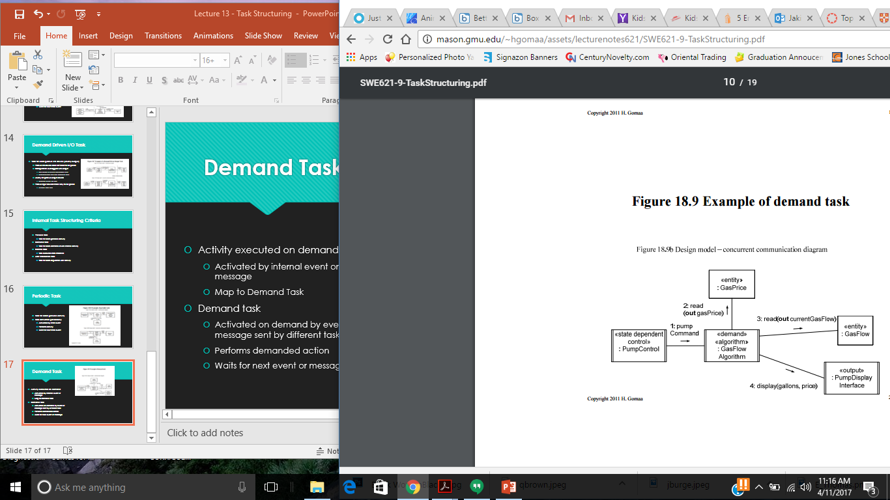
Demand Task
Activity executed on demand
Activated by internal event or message
Map to Demand Task
Demand task
Activated on demand by event or message sent by different task
Performs demanded action
Waits for next event or message

Slide 18
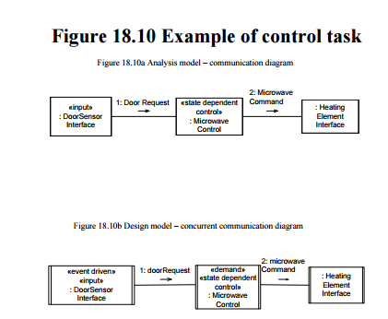
Control Task
Task executes statechart
State dependent control object executes statechart
Execution of statechart is sequential
One task for each control object
Can have multiple tasks of same type

Slide 19
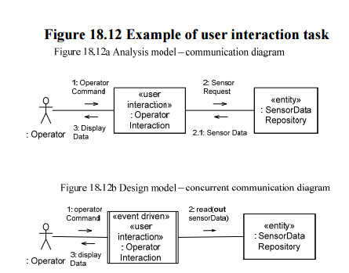
User Interaction Task
One task for each sequential user activity
Multi-user system
One task per user
User may also spawn background tasks
Windowing system
User engaged in multiple activities
Each window executes sequential activity
One task for each window

Slide 20
Steps for developing the Concurrent Task Architecture
Begin with the analysis model (integrated communication diagram)
In each case, decide whether the analysis model object should be designed as an active object (task) or a passive object in the design model
NOTE: It is possible to have multiple tasks of the same type
Determine I/O tasks
Start with the device I/O objects that interact with the outside world. Determine whether the object should be structured as an event driven I/O task, a periodic I/O task, or a demand driven I/O task
Determine Control tasks
Analyze each state dependent control object and coordinator object. Structure this object as a (usually demand driven) state-dependent control or coordinator task
Determine Periodic tasks
Analyze the internal periodic activities, which are structured as periodic tasks
Handle Other internal tasks
For each internal task activated by an internal event, structure this task as a demand driven task
Re-draw initial concurrent communication diagram showing all the tasks in the system
NOTE: The interfaces between the tasks are still simple messages as depicted on the analysis model integrated communication diagram

Slide 21
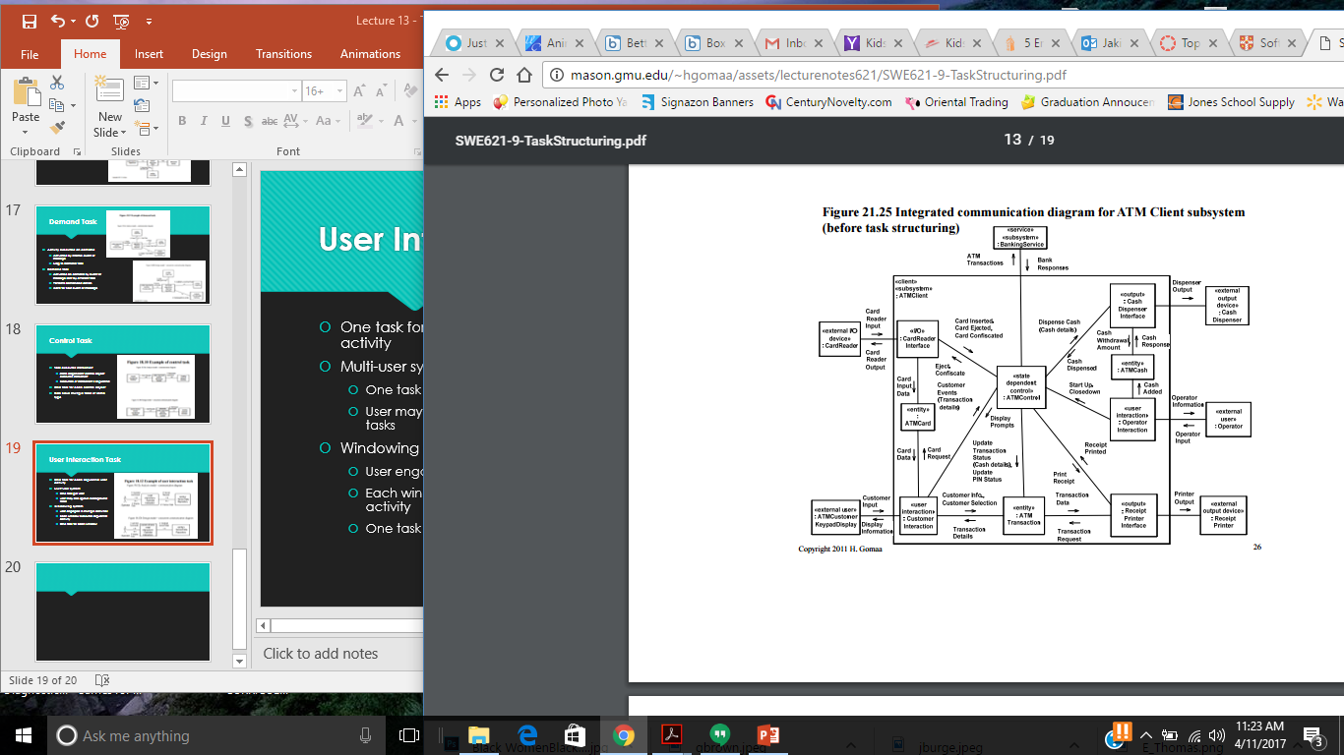
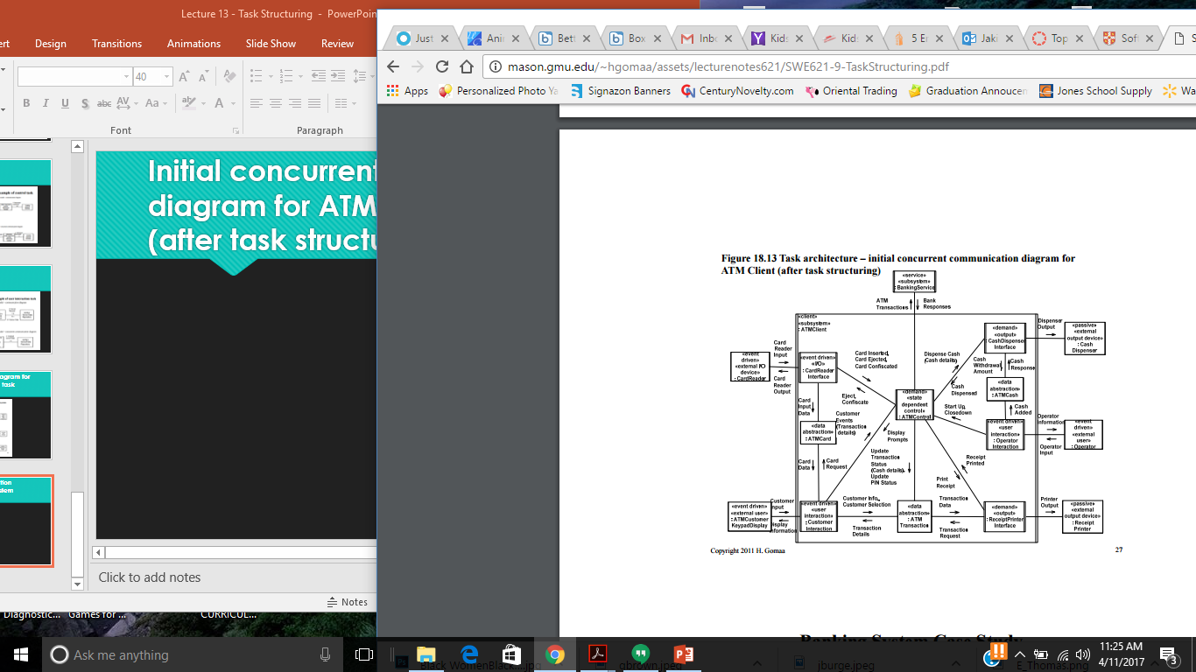
Integrated communication diagram for ATM Client subsystem (before task structuring)

Slide 22
Initial concurrent communication diagram for ATM Client subsystem (after task structuring)
NOTE
Active objects are identified
Task structuring criteria are applied (using stereotypes)
Internal task structuring criteria are applied (using stereotypes)

Slide 23
Banking System Cast Study – Task Structuring Criteria
Event driven I/O task
Card Reader Interface
Demand driven output task
Cash Dispenser Interface
Receipt Printer Interface
Event driven user interaction Task
Customer Interaction
Operator Interaction
Demand driven state dependent control task
ATM Control
Service task
Bank Service

